Slide 1
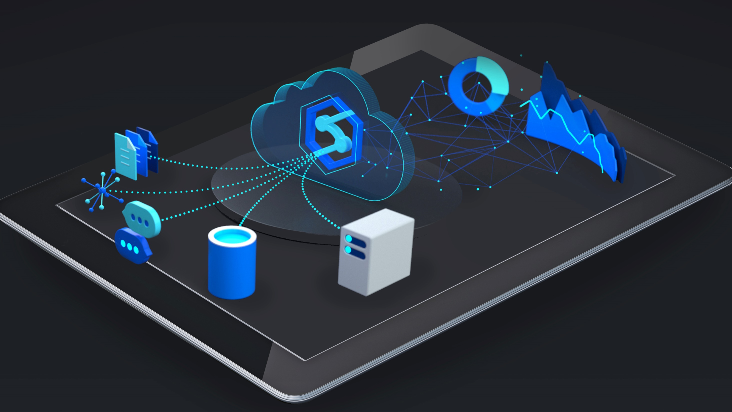
Azure Synapse Analytics

Slide 2

Analytics & AI is the #1 investment for business leaders, however they struggle to maximize ROI
80%
report struggling to become mature users of data*
55%
report data silos and data management difficulties as roadblocks*
* Harvard Business Review (2019), Understanding why analytics strategies fall short for some, but not for others
Notes:
HBR Report: https://azure.microsoft.com/en-us/resources/why-analytics-strategies-fall-short-for-some-but-not-others/

Slide 3
Businesses are forced to maintain two critical, yet independent analytics systems
Big Data
Relational Data
Experimentation
Fast exploration
Semi-structured data
Proven security & privacy
Dependable performance
Operational data
OR
Data Lake
Data Warehouse
Data warehousing & big data analytics—all in one service

Slide 4
Azure brings these two worlds together, in a single service, to provide limitless analytics
Ease of use
Fast exploration
Quick to start
Proven security
Airtight privacy
Dependable performance
Data warehousing & big data analytics—all in one service

Slide 5
Azure brings these two worlds together, in a single service, to provide limitless analytics
Azure Synapse Analytics
Data warehousing & big data analytics—all in one service

Slide 6
Introducing Azure Synapse Analytics
A limitless analytics service with unmatched time to insight, that delivers insights from all your data, across data warehouses and big data analytics systems, with blazing speed
Simply put, Azure Synapse is Azure SQL Data Warehouse evolved
We have taken the same industry leading data warehouse and elevated it to a whole new level of performance and capabilities
Notes:
Same industry leading data warehouse: https://azure.microsoft.com/en-ca/blog/analytics-in-azure-is-up-to-14x-faster-and-costs-94-less-than-other-cloud-providers-why-go-anywhere-else/

Slide 7

Azure Synapse Analytics
Limitless Scale
Powerful Insights
Unified Experience
Unmatched Security
GENERALLY AVAILABLE
Provisioned Data Warehouse
PREVIEW
On-demand Query as a Service

Slide 8
Limitless scale provides a breathtaking view of your data
All of it, from warehouses and Big Data lakes
with limitless scalability, provisioned or serverless,
and intelligently optimized workload performance.

Slide 9




A breakthrough in the cost of enterprise analytics
TPC-H Benchmark
Price-performance | Lower is better
…$564
94% less
With the best price-performance in the business
$103
Up to 14x faster and costs 94% less than other cloud providers
$48
$33
Azure Synapse
Analytics
Amazon
Redshift
Snowflake
Standard
Google
BigQuery per byte
* GigaOm TPC-H benchmark report, January 2019, “GigaOm report: Data Warehouse in the Cloud Benchmark
Notes:
GigaOm benchmark: https://azure.microsoft.com/mediahandler/files/resourcefiles/data-warehouse-in-the-cloud-benchmark/FINAL%20data-warehouse-cloud-benchmark.pdf

Slide 10
Unlock powerful insights, get a multi-layered grasp of your business
Integrated BI and machine learning drives insight for all users
from the data scientist, coding with statistics,
to the business user with Power BI.

Slide 11
Build end-to-end analytics solutions with a unified experience
A consistent version of data for everyone and all analytics use cases,
but with zero management and maintenance,
plus financially backed SLAs.

Slide 12
Rigorous assurance of safe-keeping with the most advanced security and privacy features
We protect sensitive data in real time,
monitoring and responding to threats as they arise,
with industry-leading security and privacy features
at no extra cost to you.

Slide 13
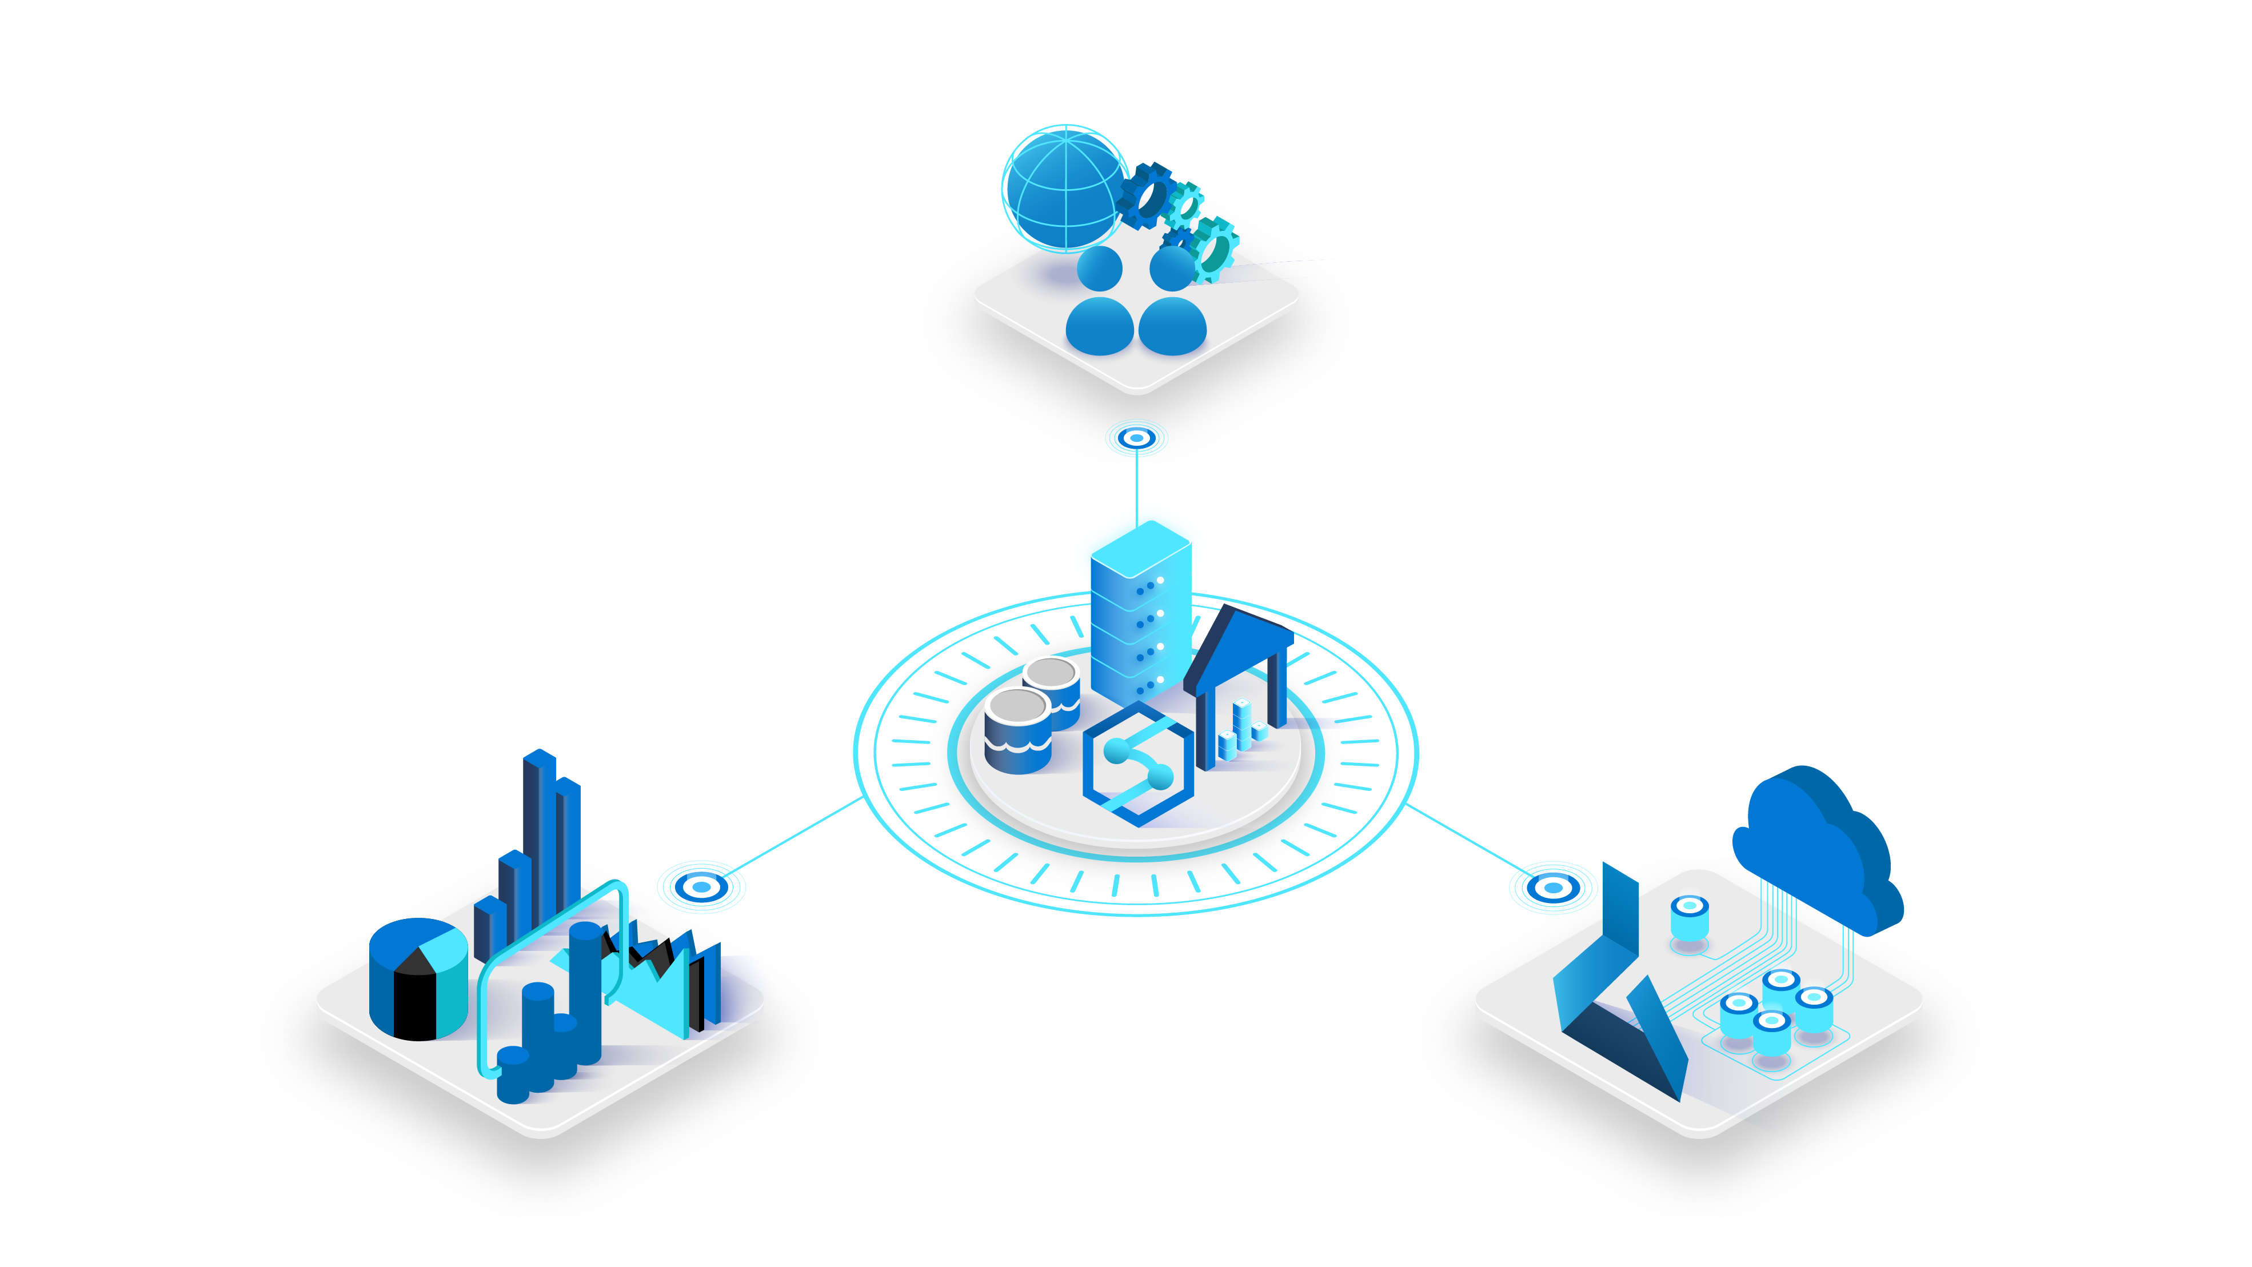
Ecosystem
Azure Synapse Analytics
Power BI
Azure Machine Learning

Slide 14
Maximize ROI with
Azure Synapse Analytics and Power BI
271% Average ROI
60%
Increased customer satisfaction
27%
Faster time to insights
26%
Lower total cost of ownership
* Forrester, October 2019, “The Total Economic Impact of Microsoft Azure Analytics with Power BI”
Notes:
Forrester report: https://azure.microsoft.com/en-us/resources/forrester-tei-microsoft-azure-analytics-with-power-bi/

Slide 15
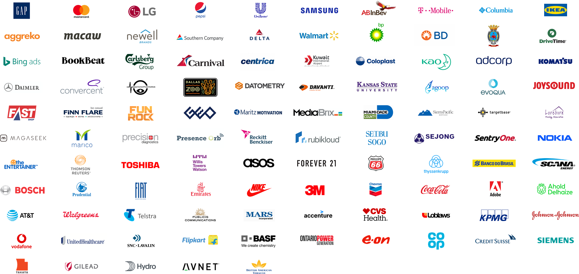
Azure Synapse Analytics Customers

Slide 16
Get started today Learn more Start building with a free trial Attend an Analytics in a Day workshop

Slide 17
Limitless scale | GA | Preview
Provisioned compute (data warehouse)
Materialized views
Workload importance
Workload isolation
On-demand query
Powerful insights
Power BI integration
Azure Machine Learning integration
Data lake exploration
Streaming analytics (data warehouse)
Apache Spark integration
Unified experience
Hybrid data ingestion
Azure Synapse studio
Unmatched security
Column- and row-level security
Dynamic data masking
Private endpoints
Azure Synapse Analytics features

